Slide 1

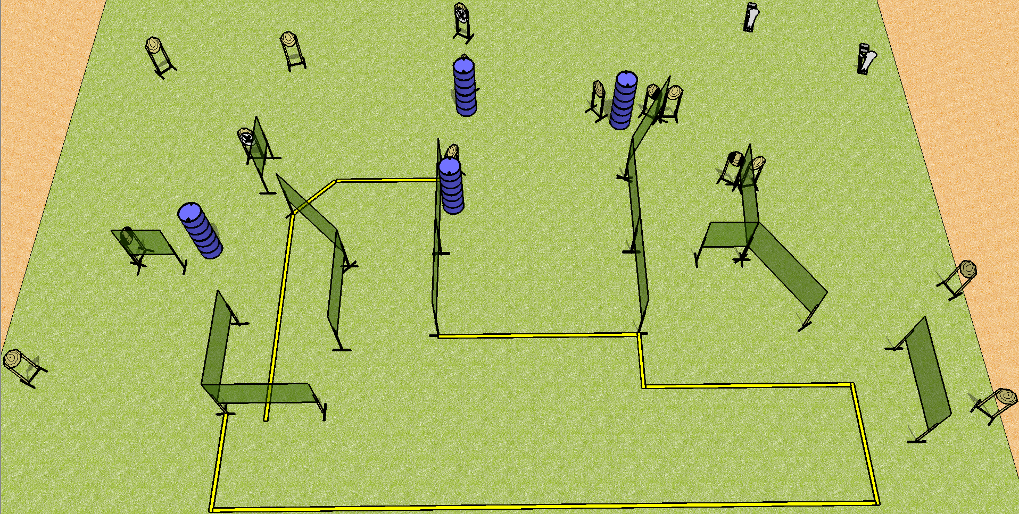
 | Dothan Practical Shooters – USPSA Match Plinko Course Designer : Drew Coleman Bay: A2
Round Count 32 rounds 15 IPSC 2 colt poppers
Equipment List 26 wall feet 13 targets (11 + 2NS) 2 tux, 2 right diag
Right Diag

Slide 2
Plinko
Written Stage Briefing
Scoring: Comstock Rounds: 32 rounds
Targets: 15 IPSC, 2 colt poppers
Handgun start position: anywhere inside the shooting area, wrists below belt. Handgun is loaded and holstered.
PCC start position: anywhere inside the shooting area, stock on belt. Loaded carbine is held with both hands, safety on.
Stage Procedure: On the audible start signal, engage targets as they become available from within the shooting area.

